Slide 1
CI/CD DevOps Pipeline Project
Names:
Tamer Ahmed
Ahmed Sherif
Mohamed Elhamy
Mina Mossad

Slide 2
overveiw
This presentation covers the complete CI/CD pipeline designed for the Spring Petclinic project, incorporating modern DevOps tools such as Docker, Docker Compose, Terraform, Ansible and Jenkins.

Slide 3
Initial Setup & Planning
Install Jenkins and Docker: Set up the Jenkins server and Docker on local or cloud environments.
Create a basic Dockerized application: Develop a simple application (e.g., a web app) and Dockerize it.
Set up Ansible: Install Ansible for configuration management.
Pipeline Plan: Plan the structure of the CI/CD pipeline (build, test, deploy) and document tasks.

Slide 4
Docker & Deployment
Integrate Docker Hub or private registry: Push Docker images to Docker Hub or a private registry.
Configure Ansible for Deployment: Write Ansible playbooks to automate application deployment to a cloud environment (e.g., AWS, GCP).
Deployment Testing: Test deployment process with Docker and Ansible to ensure smooth automation.

Slide 5
Jenkins & CI Integration
Create Jenkins Jobs: Configure Jenkins to build the Dockerized application.
1
Integrate Git: Set up GitHub or GitLab repository and integrate with Jenkins for continuous integration.
2
Automated Testing: Add basic testing (e.g., unit tests) into the Jenkins pipeline for automated builds.
3
Set Up Notifications: Configure email/Slack notifications for pipeline success or failure.
4

Slide 6
CI/CD Refinement & Final Testing
Kubernetes Integration: Optional task — configure Kubernetes to orchestrate the deployment of Docker containers if desired.
Refine the Pipeline: Refine Jenkins jobs for efficiency (e.g., parallel stages, caching).
Full Testing and Deployment: Conduct full tests of the CI/CD pipeline, from code commit to deployment.
Documentation: Complete documentation of the project, including pipeline design, deployment process, and any issues faced.

Slide 7
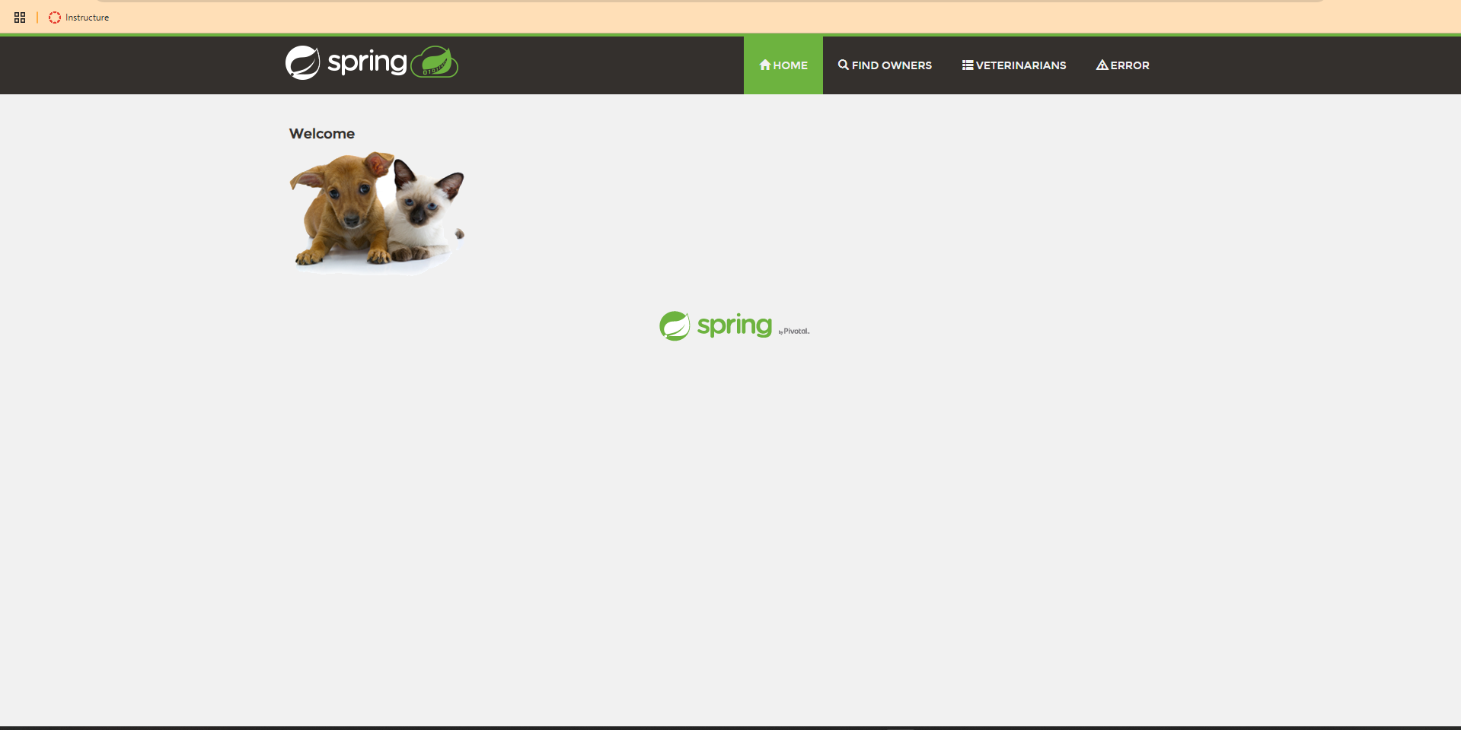
project spring petclinc

Slide 8
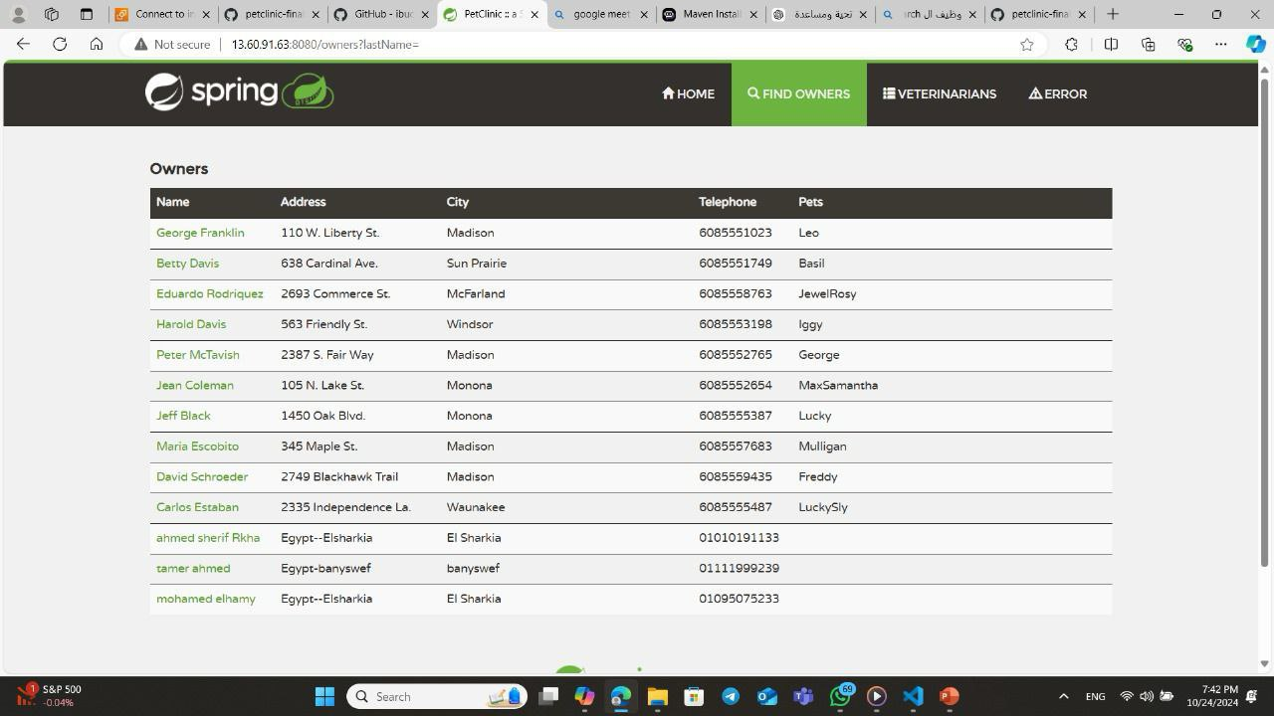
project spring petclinc

Slide 9
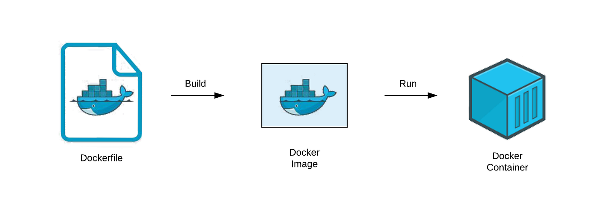
Docker
Dockerfile :To containerize the application, ensuring consistent environments across development, testing, and production.
Docker Compose:To orchestrate multi-container applications in both testing and production environments.

Slide 10
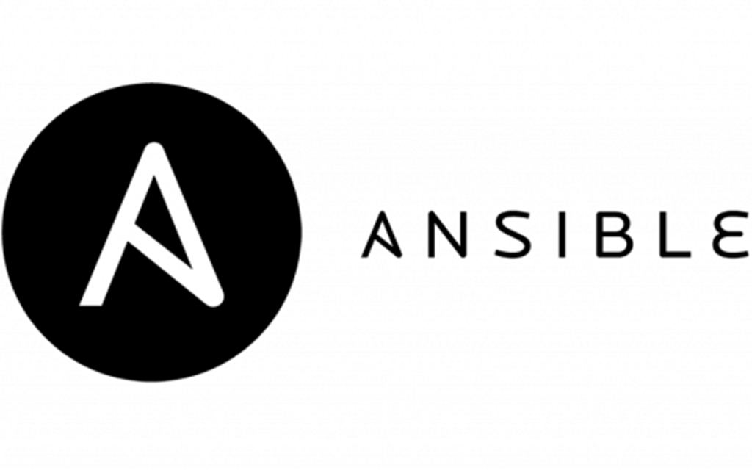

Slide 11
Configuration Management with Ansible
To configure the VM by installing Docker, Docker Compose, and deploying the application.
How to make this?
By us Playbook tasks:
Updates system packages and installs Docker and Docker Compose.
Clones the GitHub repository and runs docker-compose up to deploy the application.

Slide 12
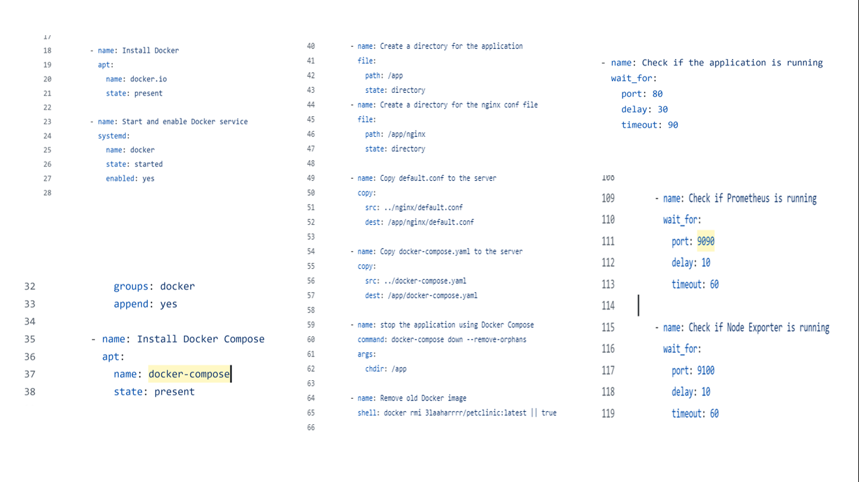

Slide 13
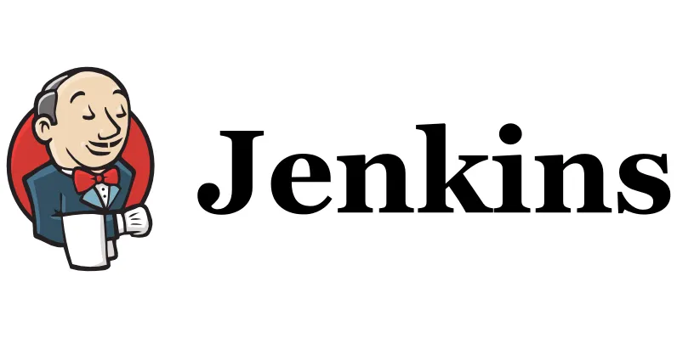

Slide 14
Jenkins CI/CD Pipeline
Automates the entire pipeline, from testing and building to deployment.
How?
Preparation: Jenkins clones the GitHub repo triggered by a webhook.
Run Tests in Parallel: Runs unit and integration tests in parallel to speed up the process.
Package Application: Packages the application into a JAR file.
Build: Builds the Docker image and pushes it to DockerHub with a version tag corresponding to the Jenkins build number.
Deployment: Runs the Ansible playbook to configure the provisioned infrastructure and deploy the application.
Deploy the Docker Image to Kubernetes Cluster: Deploys the image to a Kubernetes cluster using the provided deployment.yml and service.yml.

Slide 15
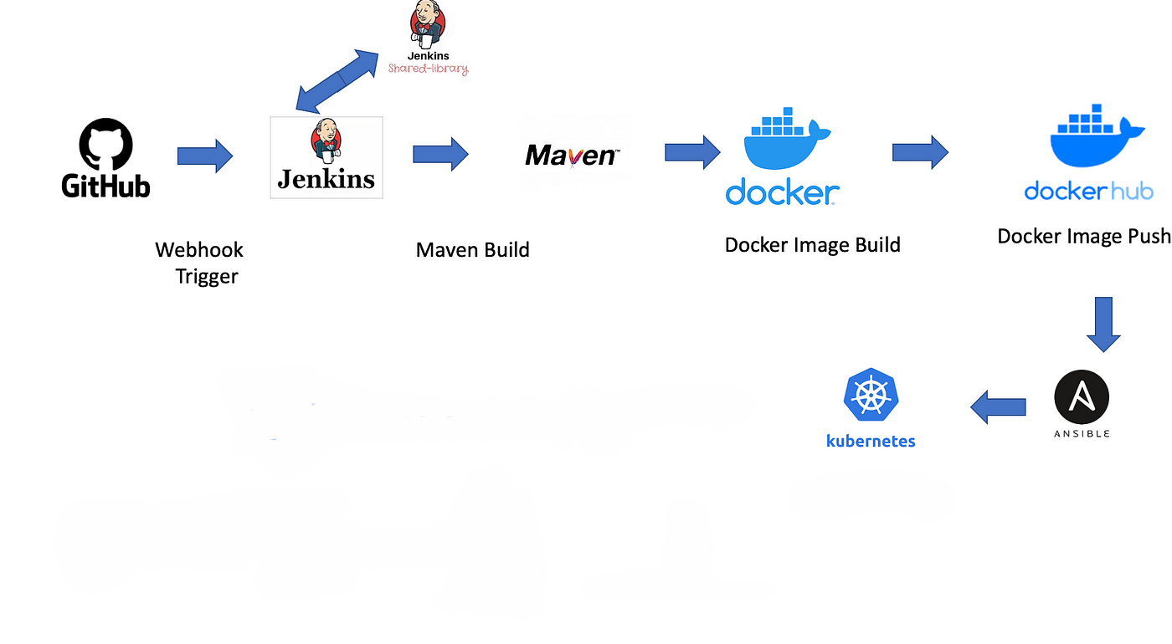
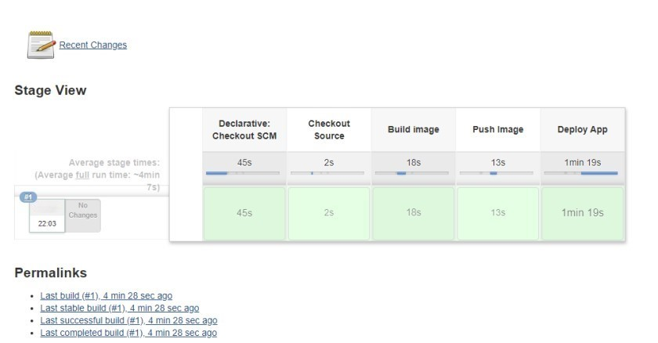

Slide 16
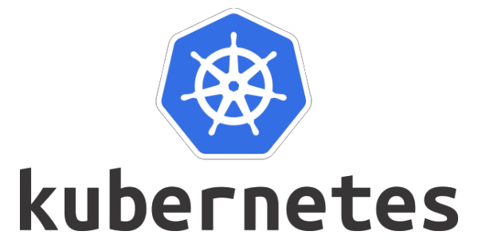

Slide 17
Kubernetes
Provides container orchestration for deploying, scaling, and managing applications and services across a cluster of nodes.
How:
ConfigMap (app-configmap):
Stores non-sensitive configuration data like environment variables required by the application (e.g., PORT, MongoDB URLs). These values are dynamically loaded by the application at runtime.
Deployment (app-deployment):
Defines how the backend application is deployed and managed. It uses a RollingUpdate strategy to ensure zero downtime during updates. The initContainer runs tests before the application container is started to verify functionality.

Slide 18
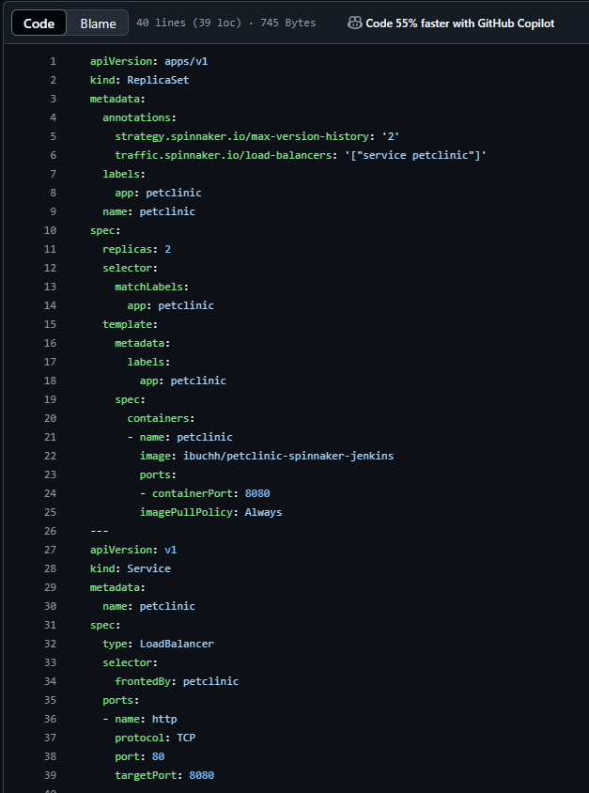
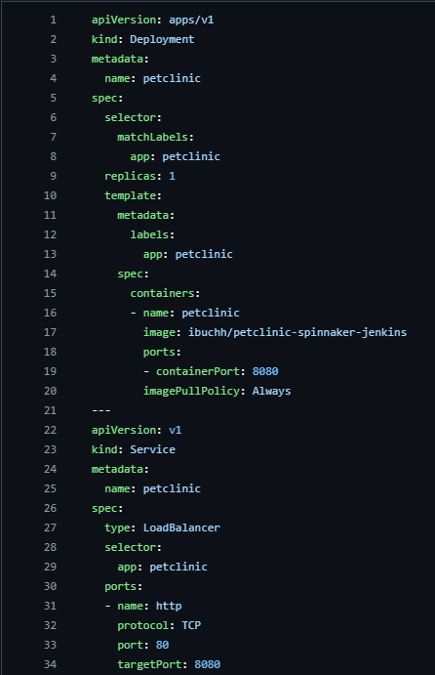
Applications that used for kubernetes

Slide 19


Slide 20
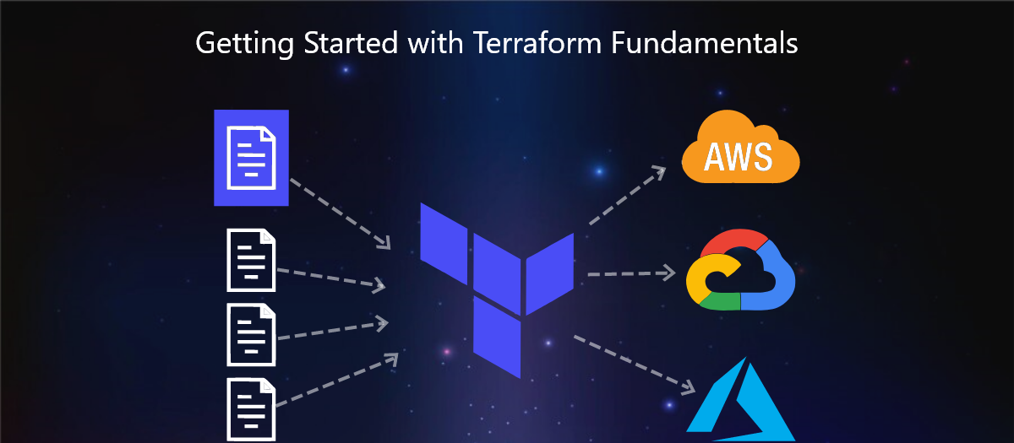
Infrastructure with terraform
To provision scalable infrastructure on Azure, including virtual machines, networking, and security groups.
How:
Virtual Network (VNet), Subnet, NSG:
Created to manage Azure networking and restrict inbound traffic based on predefined rules.
Virtual Machine:
Provisioned using an Ubuntu image and configured for SSH access and Docker installation.

Slide 21
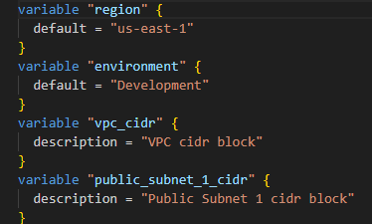

Variables and Output

Slide 22

Thank You

